Slide 1
Maximizing Profitability Through Smart Pricing Presentation

Slide 2
Agenda
Introduction
Objectives:
Step 1 Model development
Step 2 Compare the models
Step 3 Model evaluation and selection
Step 4 Model the business
Summarize and take aways

Slide 3
Introduction
Business problem:
Top Good Electronics is a company specializing in designing and manufacturing of robotic floor vacuum and mop machine.
This year, Top Good has decided to launch a direct marketing campaign and sell its products independently, rather than relying on a distribution partner. In response to the highly competitive market landscape, the company plans to leverage historical data and statistical modeling to refine its pricing strategy—enabling data-driven decision-making and strengthening its market presence.

Slide 4
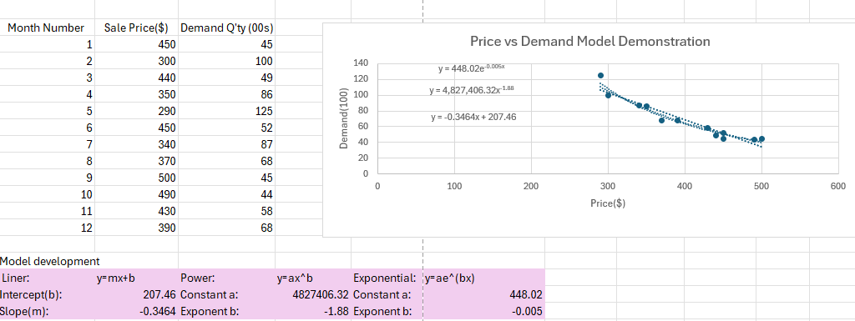
Step 1 Model development
Based on historical sales data, including price and demand trends from the past year, the marketing team has developed three predictive models to compare and identify the most effective one.
Models:
Linear,
power,
exponential

Slide 5
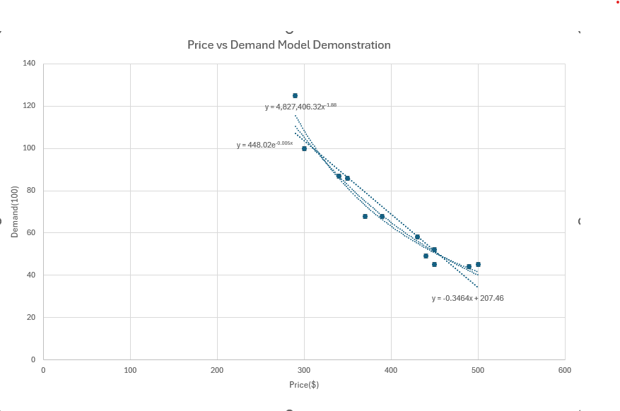
Step 2 Compare the models
Findings:
Among the line graphs from Linear, Power, and Exponential Models, the Power model appears to be more accurate, as it aligns better with the actual demand in the price vs. demand relationship.

Slide 6
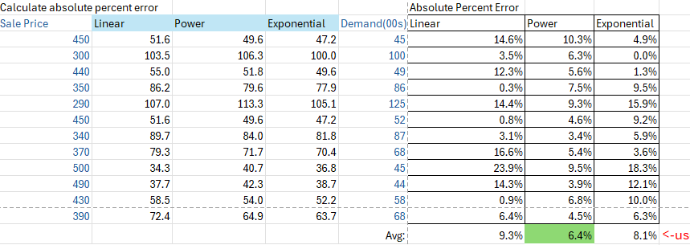
Step 3 Model evaluation and selection
Findings:
Among the three models, the Power model has the smallest absolute percent error, which is consistent with the results observed in the prediction graphs. Therefore, it is the most suitable choice for further analysis.

Slide 7
Step 4 Model the Business(Power model)
y = ax^b
x = price
a = 4827406.32
b = -1.88
Cost per unit: $250
Findings:
With a fixed cost of $250 per unit, the graph illustrates that profit increases up to a price of $530, after which it slightly decreases and remains steady thereafter.

Slide 8
Conclusion & Take Aways
Used techniques: MS Excel (graph, VLOOKUP, Linear programming and optimization ), PowerPoint
Best predictive model: power model
Pricing strategy: price the product robotic vacuum at $530 per unit will maximize annual profit.
Constrain: optimal pricing subject to change if the cost of unit changes.

Slide 9
Thank you
Lei Liu
469-892-8857
lauraliu1117@gmail.com

